Slide 1
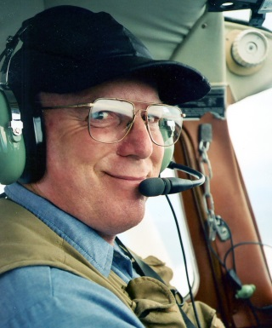
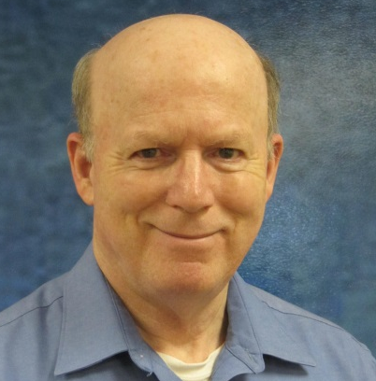
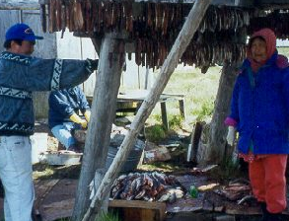
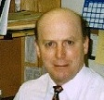
Examples of Sustainable Remote
Construction “Outside the Box”
Unique Circumstances: Unique Creativity
Dr. Paul V. Perreault, P.E.
pvpengineer@ak.net
Moolin Seminar
October 2016
Newtok
Notes:
2 Student Research Work
Studying the Thermal Regime below Buildings with frost protected shallow foundations.
(if y d p, y wnt b w a d.)
Frost protected shallow foundations are a way to protect building foundations from seasonal freezing action.
You’ll see in the following slides that what happens is that the heat from the building is confined below the building –
enough that the freezing isotherm does not extend below the footing.
This is an alternative construction method for foundations – usually where there is no permafrost below the footing.

Slide 2
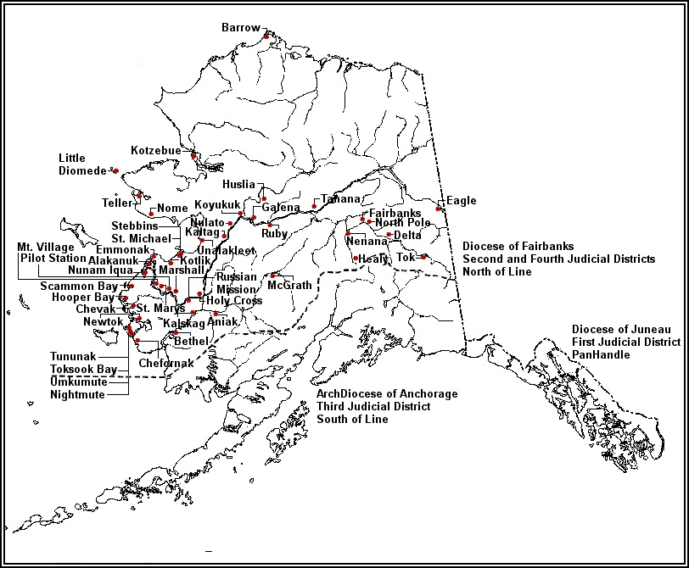
35 Yrs. 50 Villages
Northern 2/3 Alaska
Notes:
Specifics vary, each site
Why 3 Why do this at all? Why do it this way? Why do it now?
Answer the question… So what? // why bother?
READ poem. THE BRIDGE BUILDER
An old man, going a lone highway,
Came at the evening, cold and gray,
To chasm, vast and deep and wide,
Through which was flowing a sullen tide.
The old man crossed in the twilight dim;
The sullen stream had no fears for him;
But he turned when safe on the other side
And built a bridge to span the tide.
"Old man," said a fellow pilgrim near,
"You are wasting strength with building here;
Your journey will end with the ending day;
You never again must pass this way;
You have crossed the chasm, deep and wide --
Why build you the bridge at the eventide?"
The builder lifted his old gray head:
"Good friend, in the path I have come," he said,
"There followeth after me today
A youth whose feet must pass this way.
This chasm that has been naught to me
To that fair-haired youth may a pit-fall be,
He, too, must cross in the twilight dim;
Good friend, I am building the bridge for him."
Will Allen Dromgoole
http://www.massageprofessionals.com/group/positiveattitudes/forum/topics/philosophies-that-keep-you

Slide 3
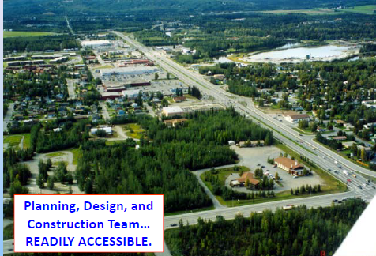
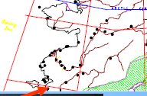
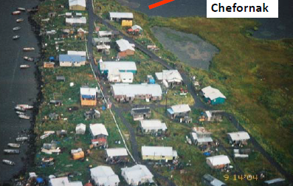
Sustainable Considerations
Northern 2/3Alaska
Notes:
Specifics vary, each site
Why 3 Why do this at all? Why do it this way? Why do it now?
Answer the question… So what? // why bother?
READ poem. THE BRIDGE BUILDER
An old man, going a lone highway,
Came at the evening, cold and gray,
To chasm, vast and deep and wide,
Through which was flowing a sullen tide.
The old man crossed in the twilight dim;
The sullen stream had no fears for him;
But he turned when safe on the other side
And built a bridge to span the tide.
"Old man," said a fellow pilgrim near,
"You are wasting strength with building here;
Your journey will end with the ending day;
You never again must pass this way;
You have crossed the chasm, deep and wide --
Why build you the bridge at the eventide?"
The builder lifted his old gray head:
"Good friend, in the path I have come," he said,
"There followeth after me today
A youth whose feet must pass this way.
This chasm that has been naught to me
To that fair-haired youth may a pit-fall be,
He, too, must cross in the twilight dim;
Good friend, I am building the bridge for him."
Will Allen Dromgoole
http://www.massageprofessionals.com/group/positiveattitudes/forum/topics/philosophies-that-keep-you

Slide 4
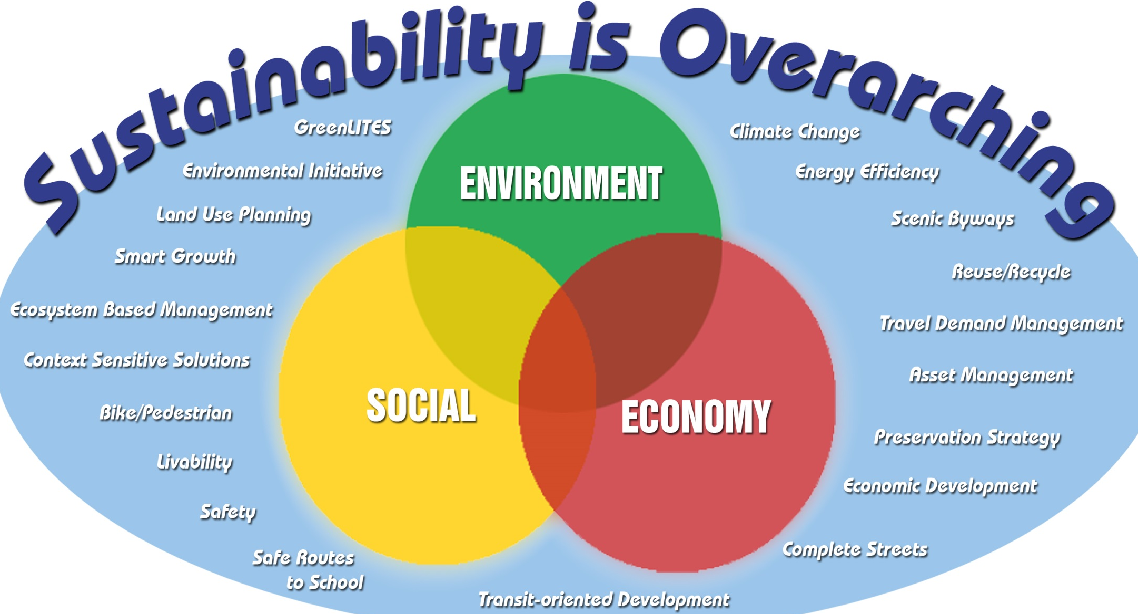

Project Support - Project Itself - O&M, End of Life
https://www.dot.ny.gov/programs/greenlites/repository/overarching.jpg
Notes:
not in isolation.

Slide 5
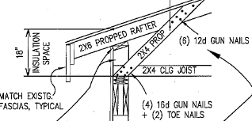
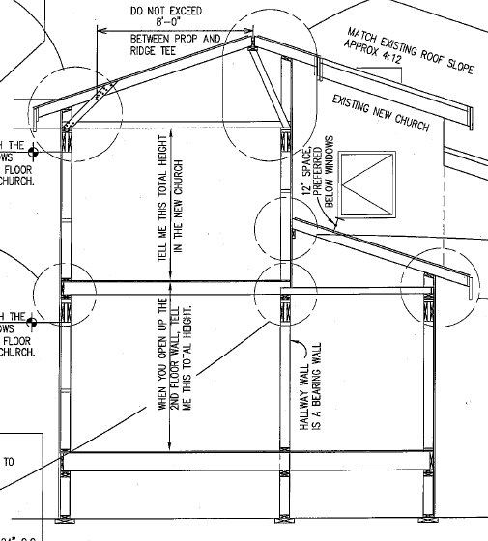
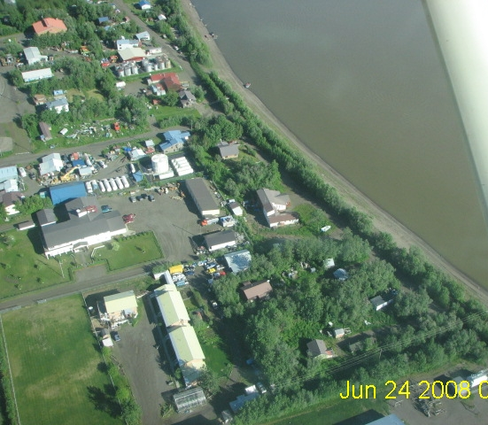
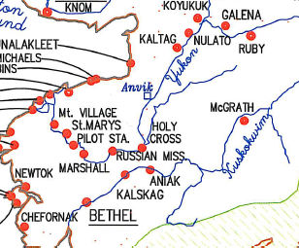
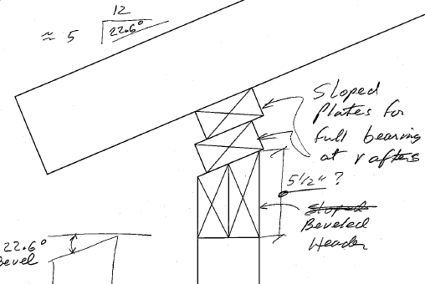
Sustainability is Overarching
Project Support / Project Itself / O&M, End of Life
ANIAK: by Design w/Chuathbaluk Materials
Notes:
Show on Google Earth?

Slide 6
Sustainability is Overarching
Project Support / Project Itself / O&M, End of Life
ANIAK: by Design w/Chuathbaluk Materials
Notes:
Show on Google Earth?

Slide 7
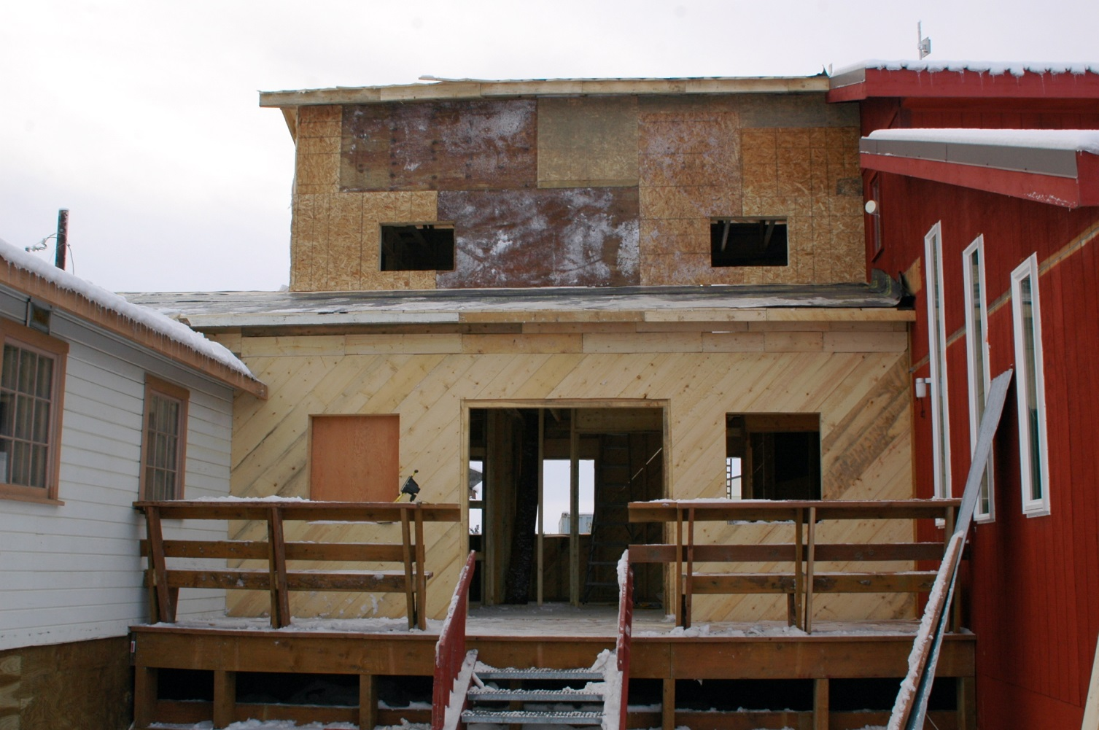
Sustainability is Overarching
Project Support / Project Itself / O&M, End of Life
ANIAK – Design w/Chuathbaluk Materials
Notes:
Show on Google Earth?

Slide 8
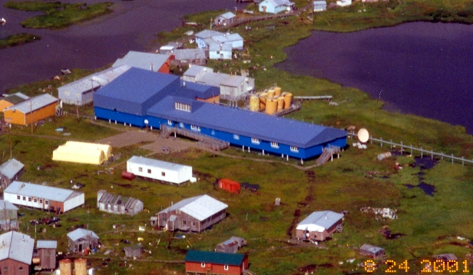
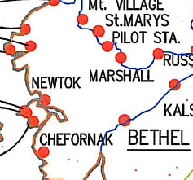
Sustainability is Overarching
Project Support / Project Itself / O&M, End of Life
By Design: AKIUK MEMORIAL SCHOOL
LOWER KASIGLUK
Notes:
Show on Google Earth?

Slide 9
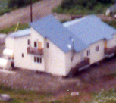
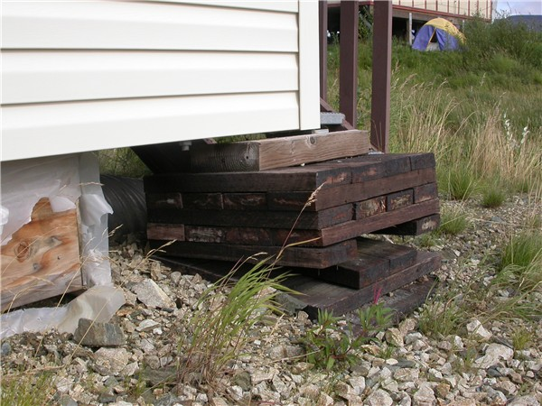
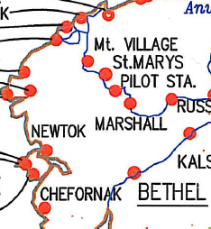
Sustainable?
Sustainability is Overarching
Project Support / Project Itself / O&M, End of Life
By Design: FORTUNA LEDGE (MARSHALL)
SITE DEVELOPMENT, LAY DOWN EXAMPLES
> 90% Local Labor
Durability ~ Understand & Provide Redundancy
Use Multiple Spans; Avoiding Simple Spans
Recall Bulking Factors, Consolidation, Erosion
Notes:
maintenance considerations?

Slide 10
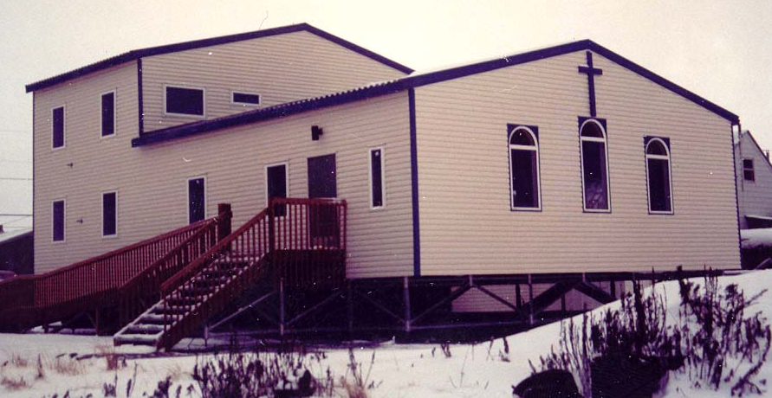
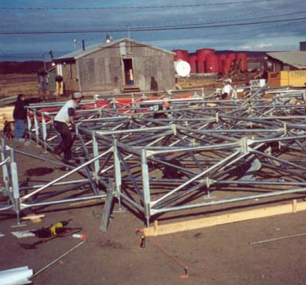
Sustainability is Overarching
Project Support / Project Itself / O&M, End of Life
By Design: STEBBINS, St. MICHAEL
On Surface. Move? Adjustable?
Notes:
Show on Google Earth?

Slide 11
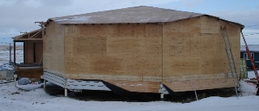
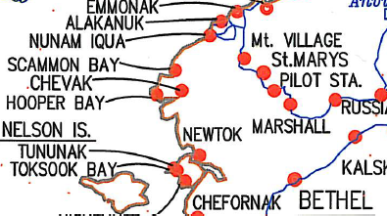
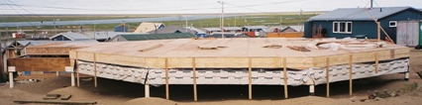
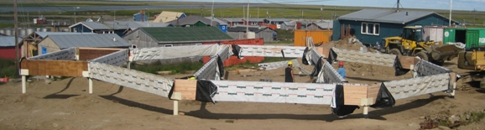
Sustainable Materials
Sustainability is Overarching
Project Support / Project Itself / O&M, End of Life
SCAMMON BAY:
Cultural Support – R.E.A.L takes time.
Site Planning, Floor Plans, Roof Plans
R.E.A.L: Takes time
Human
Ecology
Notes:
Show on Google Earth?

Slide 12
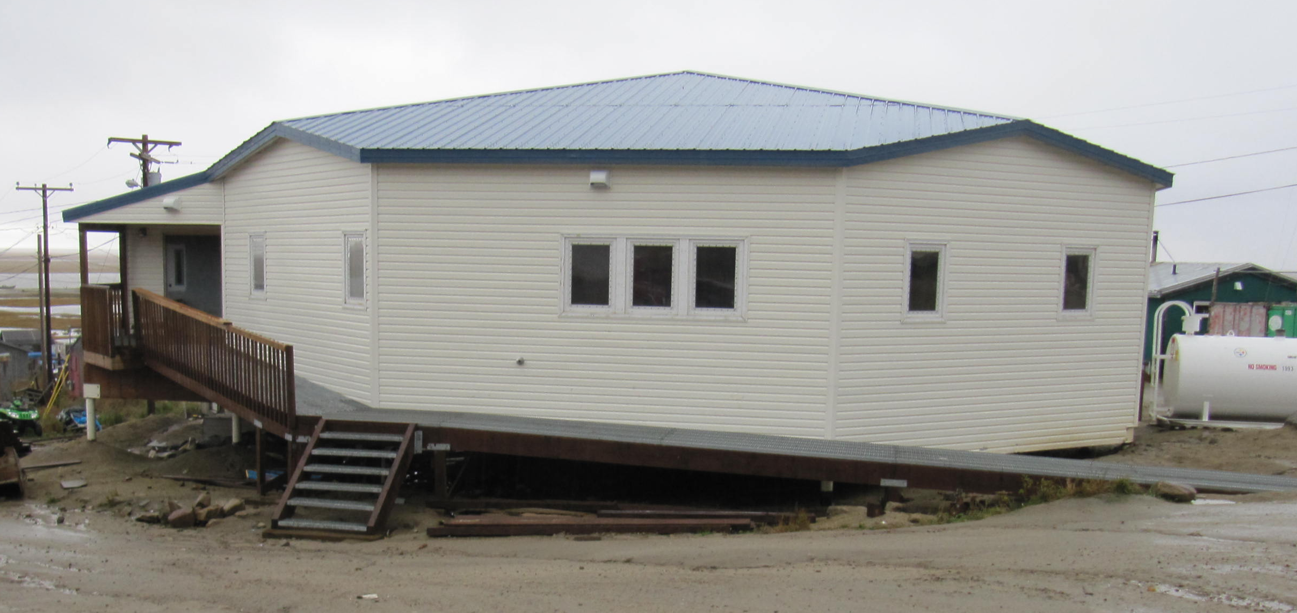
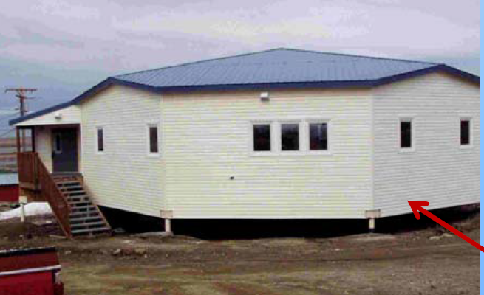
Sustainable Materials
Sustainability is Overarching
Project Support / Project Itself / O&M, End of Life
SCAMMON BAY:
Aniak -- Chuathbaluk
Integrated Project Delivery – Takes partnering.
~ 90% in 2011
Local labor. Owner provided materials.
Notes:
Show on Google Earth?

Slide 13
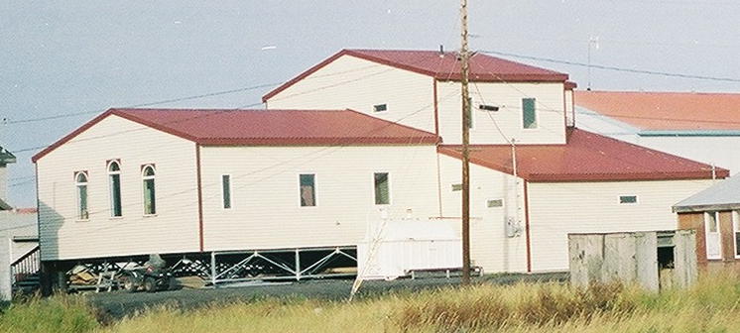
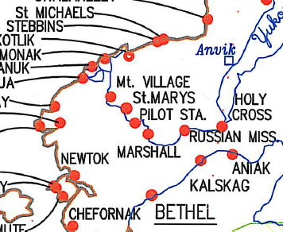
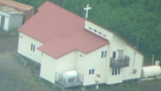
Sustainable?
Sustainability is Overarching
Project Support / Project Itself / O&M, End of Life
PILOT STATION, STEBBINS, ST. MICHAEL, ++
> 90% Local Labor
Key Leads. OJT.
Job checking!
> 90% Local Labor
Notes:
maintenance considerations?

Slide 14
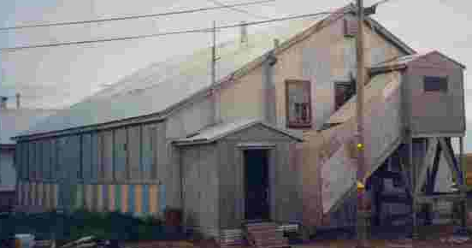
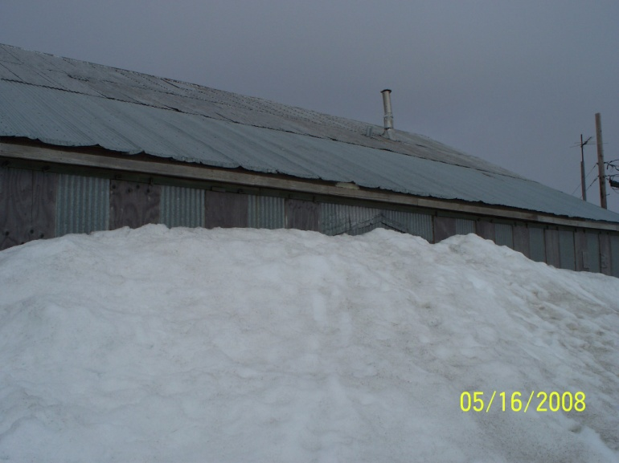
Sustainable?
Sustainability is Overarching
Project Support / Project Itself / O&M, End of Life
SITE DEVELOPMENT, LAY DOWN EXAMPLES
Demolition = Repurposing (not trash)
St. Michael
Hooper Bay
> 90% Local Labor
Notes:
maintenance considerations?

Slide 15
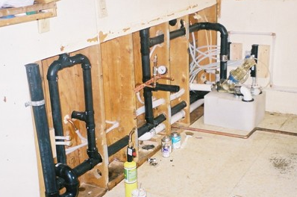
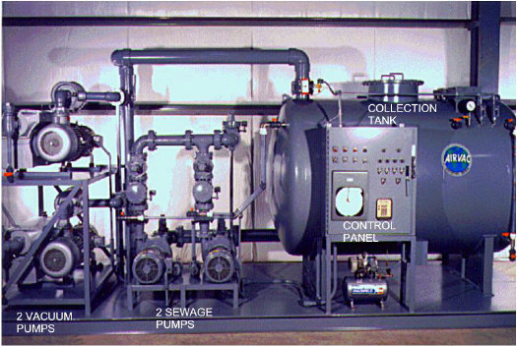
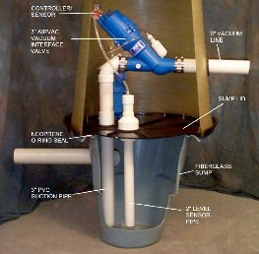
Sustainable?
Sustainability is Overarching
Project Support / Project Itself / O&M, End of Life
Operator Training & Redundant Labor
SITE DEVELOPMENT, LAY DOWN EXAMPLES
St. Michael
> 90% Local Labor
Notes:
maintenance considerations?

Slide 16
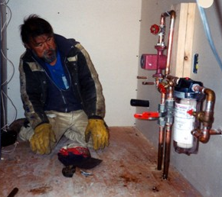
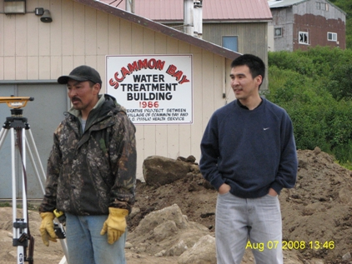
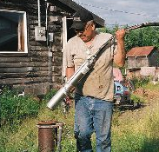
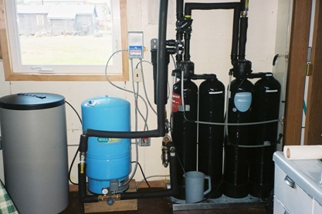
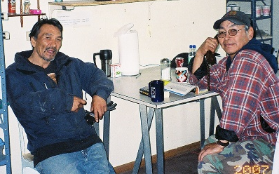
Sustainable?
Sustainability is Overarching
Project Support / Project Itself / O&M, End of Life
MENTORING
TVEP
RSS
ANSEP, ++
SITE DEVELOPMENT, LAY DOWN EXAMPLES
> 90% Local Labor
Local Wisdom/Talent
Respect, Trust, Verify
Notes:
maintenance considerations?

Slide 17
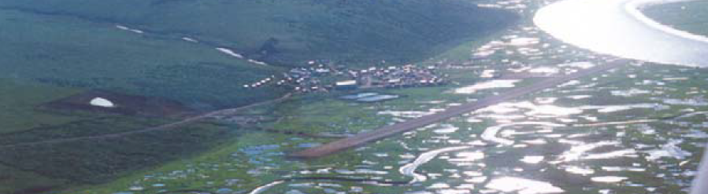
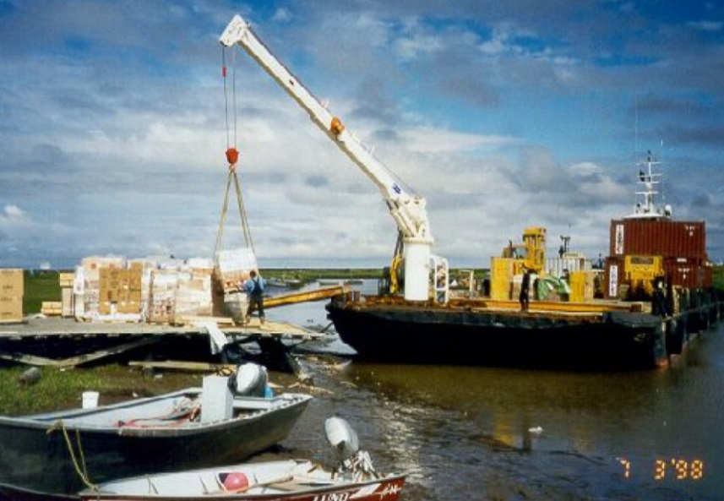
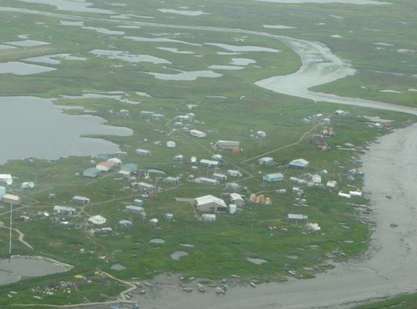
Sustainable?
Sustainability is Overarching
Project Support / Project Itself / O&M, End of Life
Transportation = Lifeline Protection
Scammon
Bay
Newtok
> 90% Local Labor
Notes:
maintenance considerations?

Slide 18
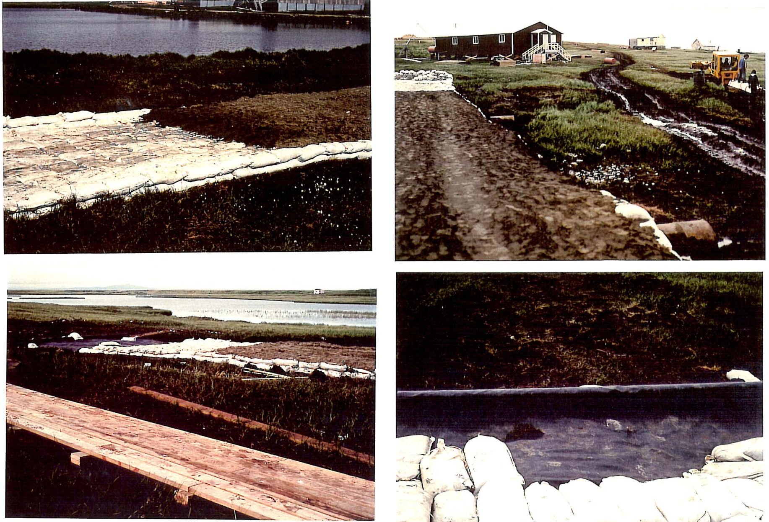
Sustainable?
Sustainability is Overarching
Project Support / Project Itself / O&M, End of Life
Transportation = Lifeline Protection
> 90% Local Labor
Chevak
Notes:
maintenance considerations?

Slide 19
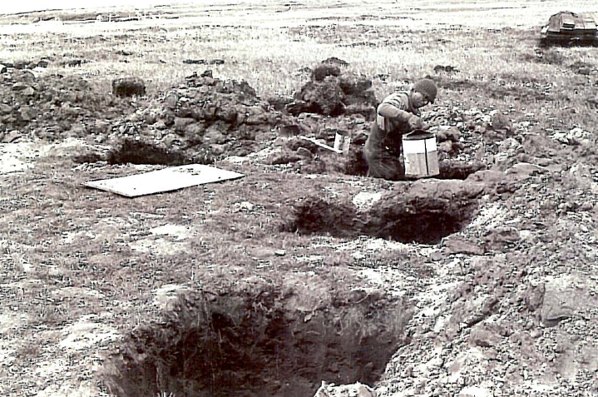
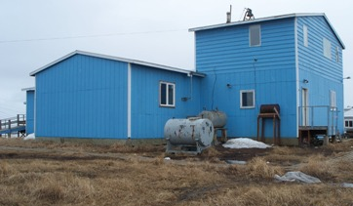
Sustainable?
Sustainability is Overarching
Project Support / Project Itself / O&M, End of Life
Climate Projections
> 90% Local Labor
Chevak
Notes:
maintenance considerations?

Slide 20
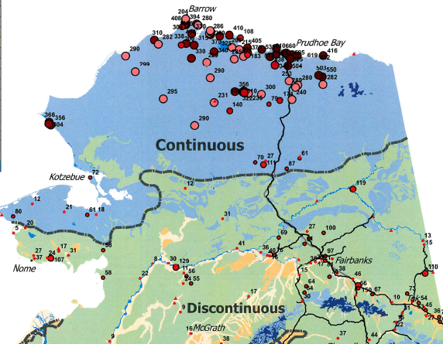
Sustainable?
Sustainability is Overarching
Project Support / Project Itself / O&M, End of Life
Climate Projections
Frozen
Sites
> 90% Local Labor
ThawedSites
Institute of Northern Engineering, UAF, 2008. Used by permission.
Notes:
maintenance considerations?

Slide 21
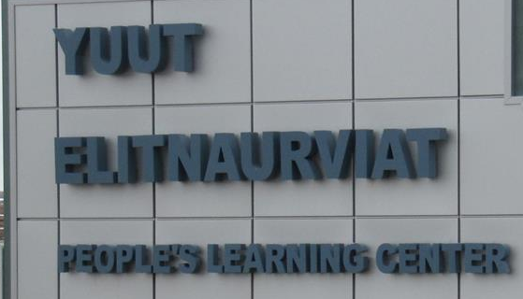
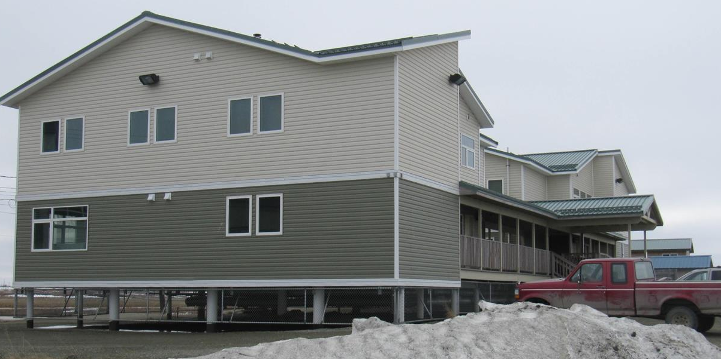


Sustainable?
Sustainability is Overarching
Project Support / Project Itself / O&M, End of Life
Climate Projections
> 90% Local Labor
Frozen
Sites
Bethel Hospital
Notes:
maintenance considerations?

Slide 22

Sustainable Methods?
Sustainability is Overarching
Project Support / Project Itself / O&M, End of Life
Climate Projections
A. Seasonal Insulation
  active layer
  frost heave
  COOLS the PF
B. Permanent insulation…
  active layer
  frost heave
  WARMS the PF
C. Alternative – Shallow Footing on PF (Chevak)
Royek, 1988. Ametek Lit.

Slide 23

WARM FOOTINGS - CRREL Example
Sustainability is Overarching
Project Support / Project Itself / O&M, End of Life
Climate Projections
4” XPS
6 Ft. Out
http://www.crrel.usace.army.mil/cerd/build-and-util/foundations.html

Slide 24

Sustainable Methods?
Climate Projections
Sustainability is Overarching
Project Support / Project Itself / O&M, End of Life
Recall: Goldratt, E. (1992). “THE GOAL.”
And – How do we cut $1 million from a project?
Okay, so – What About Little things? or Larger?

Slide 25


Partnering
JV, interstate,
Network, AZ
Sustainability is Overarching
Project Support / Project Itself / O&M, End of Life
Hmm. What About… Solar Electric?
Ruby – Yes
Scammon – No
Net Metering? Avoided Cost?
Public Policy ~ Economics ➔ Selection Process
https://inventively.com/search/trademarks/87120143
Notes:
maintenance considerations?

Slide 26



Partnering
JV, interstate,
Network, AZ
Sustainability is Overarching
Project Support / Project Itself / O&M, End of Life
Yes Goldratt, E. (1992). “The GOAL.” And - What About…
https://inventively.com/search/trademarks/87120143
Notes:
maintenance considerations?

Slide 27

Sustainability is Overarching
Project Support / Project Itself / O&M, End of Life
Hmm. What About… Geothermal Water? Scale?
http://www.vici-labs.com/outcomes---examples.html
Notes:
maintenance considerations?

Slide 28


Small. Light.
One person remote Visits?
Surveying?
Sustainability is Overarching
Project Support / Project Itself / O&M, End of Life
Hmm. What About… Portable Pure Water
http://newatlas.com/roving-blue-ozone-pen/45969/
Notes:
maintenance considerations?

Slide 29

Sustainability is Overarching
Project Support / Project Itself / O&M, End of Life
Hmm. What About… Biomass Heat/Power
VÖLTER
Where?
(In town?)
Where Not?
(Remote?)
CEO: Jarno Haapakoski. ACEP UAF Presentation Sep 20, 2016
http://www.biomassinnovation.ca/pdf/Tour_Nov14/Additional/E_Volter%20presentation%20EN.pdf
Notes:
maintenance considerations?

Slide 30



Sustainability is Overarching
Project Support / Project Itself / O&M, End of Life
Hmm. What About… Really Simple…
http://amazyble.com/green-tech/beer-company-develops-
edible-six-pack-rings-feed-rather-kill-marine-life/
Notes:
maintenance considerations?

Slide 31

Sustainability is Overarching
Project Support / Project Itself / O&M, End of Life
Step by Step. Keep it Simple
Where?
(In town?)
Where Not?
(Remote?)
Notes:
maintenance considerations?

Slide 32

Sustainability is Overarching
Project Support / Project Itself / O&M, End of Life
Seems Like The River Has Moved.
Notes:
maintenance considerations?

Slide 33


Thank You for Coming.
A Life Long Learning Presentation
by Dr. Paul V. Perreault, P.E.
http://www.wunderground.com/US/AK/Fairbanks.html
Notes:
74 Thanks!
Funding by:
CCHRC
EPSCoR
PTF

